Slide 1
Final Engagement
Attack, Defense & Analysis of a Vulnerable Network

Slide 2
Table of Contents
This document contains the following resources:
Network Topology & Critical Vulnerabilities
Traffic Profile
Normal Activity
Malicious Activity

Slide 3
Network Topology
& Critical Vulnerabilities
‹#›

Slide 4
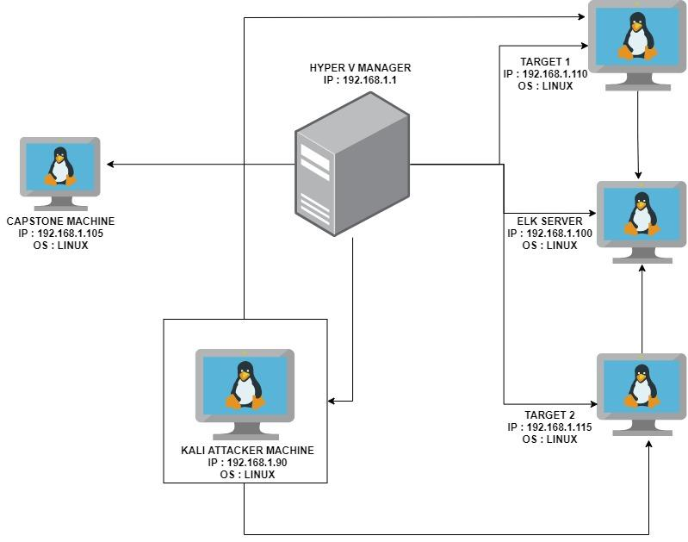
Network Topology
Network
Address Range: 192.168.1.0/24
Netmask: 255.255.255.255
Gateway: 10.0.0.1
Machines
IPv4: 192.168.1.90
OS: LINUX
Hostname: KALI
IPv4: 192.168.1.100
OS: LINUX
Hostname: ELK
IPv4: 192.168.1.110
OS: LINUX
Hostname: TARGET 1
IPv4: 192.168.1.115
OS: LINUX
Hostname: TARGET 2

Slide 5
Critical Vulnerabilities: Target 1
Our assessment uncovered the following critical vulnerabilities in Target 1.
Vulnerability | Description | Impact
WEAK PASSWORD | A USER ON THE SYSTEM HAS A WEAK PASSWORD WHICH WAS EASILY GUESSED. THE PASSWORD WAS THE SAME AS THE USERNAME. | AN ATTACKER CAN GUESS THE PASSWORD OR USE A DICTIONARY ATTACK TO GAIN ACCESS VERY EASILY TO THE SYSTEM.
WORDPRESS USER ENUMERATION | A simple wpscan enumeration scan for vulnerabilities on the wordpress site revealed two users. | An attacker will gain access to users on the site and any vulnerabilities related to the wordpress site.
ALLOWS ESCALATING PRIVILEGES TO ROOT WITH A PYTHON SCRIPT. | The system allowed for escalation of privileges to root with a simple python script after gaining access. | With root access, an attacker can inflict major damages to a compromised machine.

Slide 6
Critical Vulnerabilities: Target 1
continued
vulnerabilities
Vulnerability | Description | Impact
Wordpress configuration file for SQL databases stored in plain text. | The username and password for the sql database was stored in plain text in the wp-config.php file | This grants an attacker access to the sql database and sensitive information.

Slide 7
Critical Vulnerabilities: Target 2
Our assessment uncovered the following critical vulnerabilities in Target 2.
Vulnerability | Description | Impact
APACHE VERSION OUTDATED | A simple nikto scan revealed the apache version running in this server is outdated and vulnerable. | Bad actors could exploit vulnerabilities related to the outdated version and gain access to the server.
VULNERABLE TO URL BRUTE FORCING. | This vulnerability allows an attacker to brute force and discover directories on a server | Attackers can gain access to hidden directories within the server.
NETCAT REVERSE SHELL AND REMOTE CODE EXECUTION. | A bash script was uploaded to the server, using a netcat listener and the browser, a reverse shell was achieved. | A reverse shell will grant an attacker unauthorized access to the server and to sensitive data

Slide 8
Traffic Profile
‹#›

Slide 9
Traffic Profile
Our analysis identified the following characteristics of the traffic on the network:
Feature | Value | Description
Top Talkers (IP Addresses) | 172.16.4.205 (16m bytes) 166.62.11164 (10m bytes) | Machines that sent the most traffic.
Most Common Protocols | TCP, UDP, TLSv1.2 | Three most common protocols on the network.
# of Unique IP Addresses | 810 | Count of observed IP addresses.
Subnets | 172.16.4.0/24, 10.0.0.0/24, 10.6.12.0/24 | Observed subnet ranges.
# of Malware Species | 49 | Number of malware binaries identified in traffic.
Notes:
You may have more than 2 subnets.

Slide 10
Behavioral Analysis
Purpose of Traffic on the Network
Users were observed engaging in the following kinds of activity.
“Normal” Activity
Watching youtube
visiting google.com
Downloading images
visiting music websites
Suspicious Activity
Setting up an Active Directory network
Downloading malware
copyright infringement downloads using torrents.

Slide 11
Normal Activity
‹#›

Slide 12
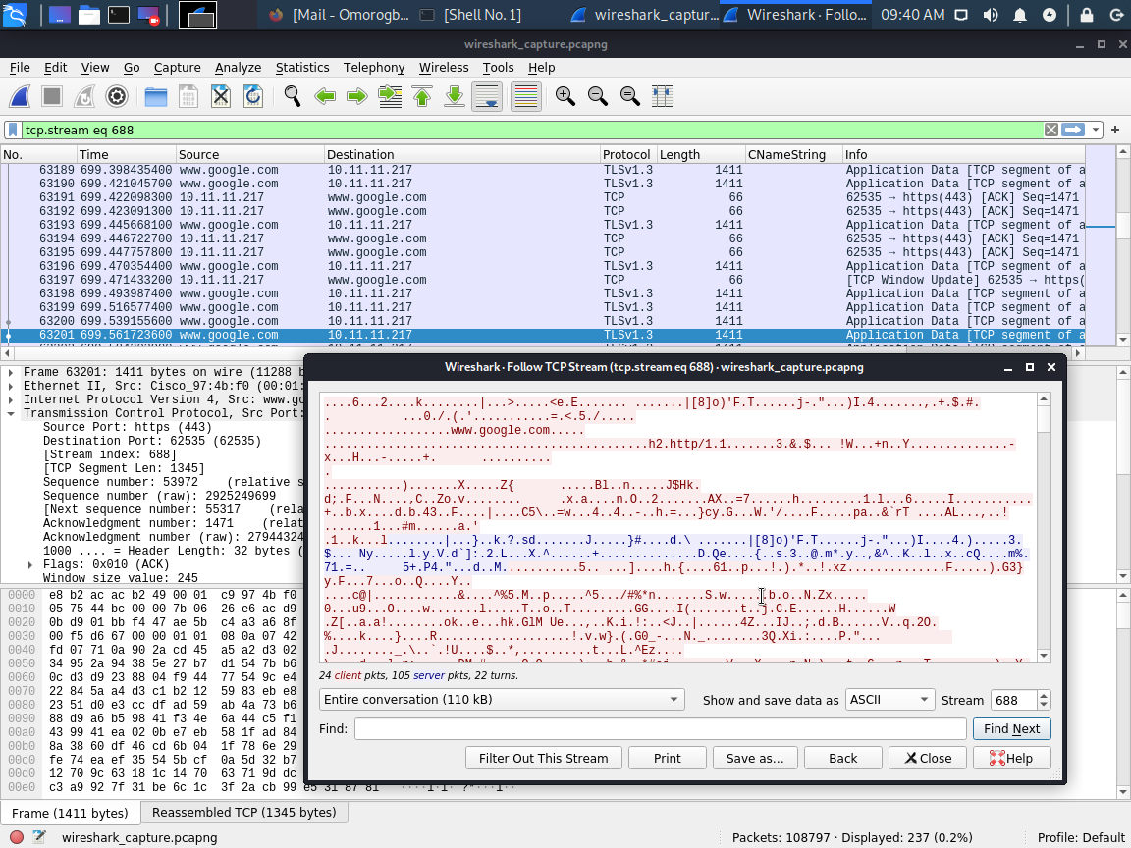
VISITING GOOGLE.COM
Summary
There was significant traffic to google.com using TCP and TLSv1.3 protocol. This is regarded as a normal activity. Users seem to be seeking information about different things.

Slide 13
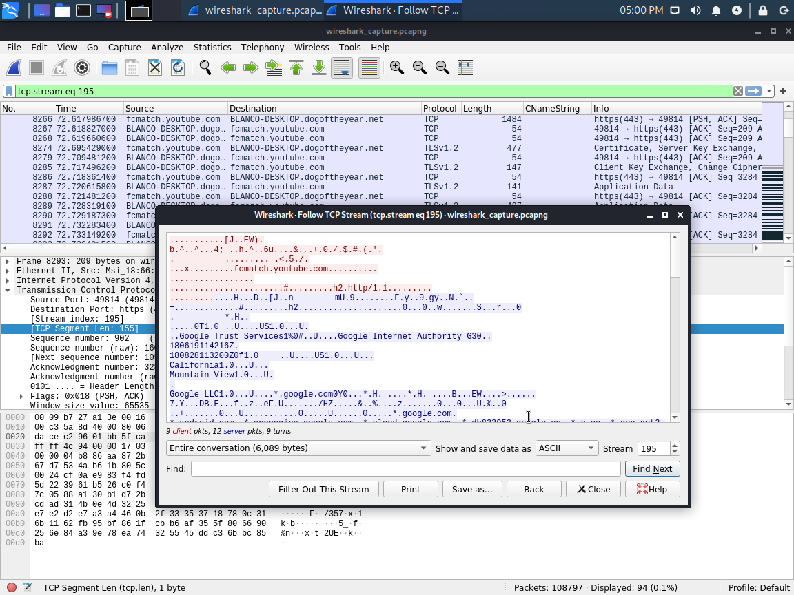
WATCHING YOUTUBE.COM
Summary
There was significant traffic to youtube.com over TLSv1.2 and TCP protocol.

Slide 14
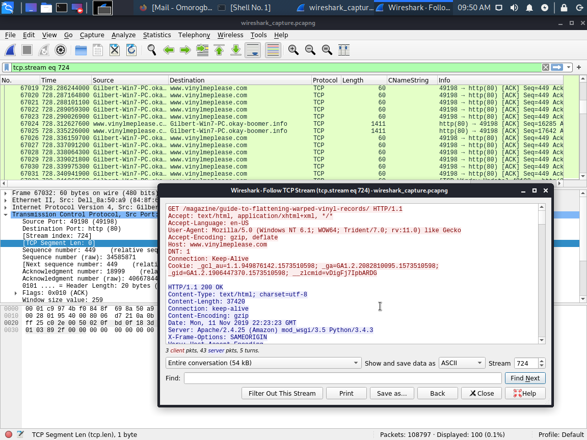
VISITING MUSIC WEBSITES.
Summary
There was also significant traffic to a musical website called vinylmeplease.com via TCP protocol. this is a music subscription sites. User were listening to and downloading music.

Slide 15
Malicious Activity
‹#›

Slide 16
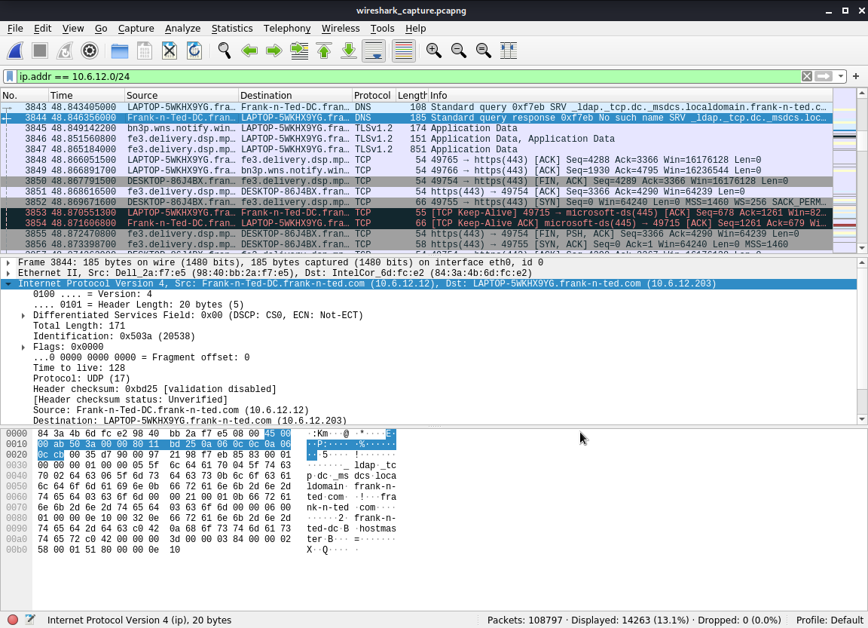
SETTING UP AN ACTIVE DIRECTORY NETWORK.
Summary :
It was observed that an active directory network has been created within the corporate network. Further investigation revealed the AD network to be : frank-n-ted.com. The domain controller of this AD is located at this IP address : 10.6.12.12.

Slide 17
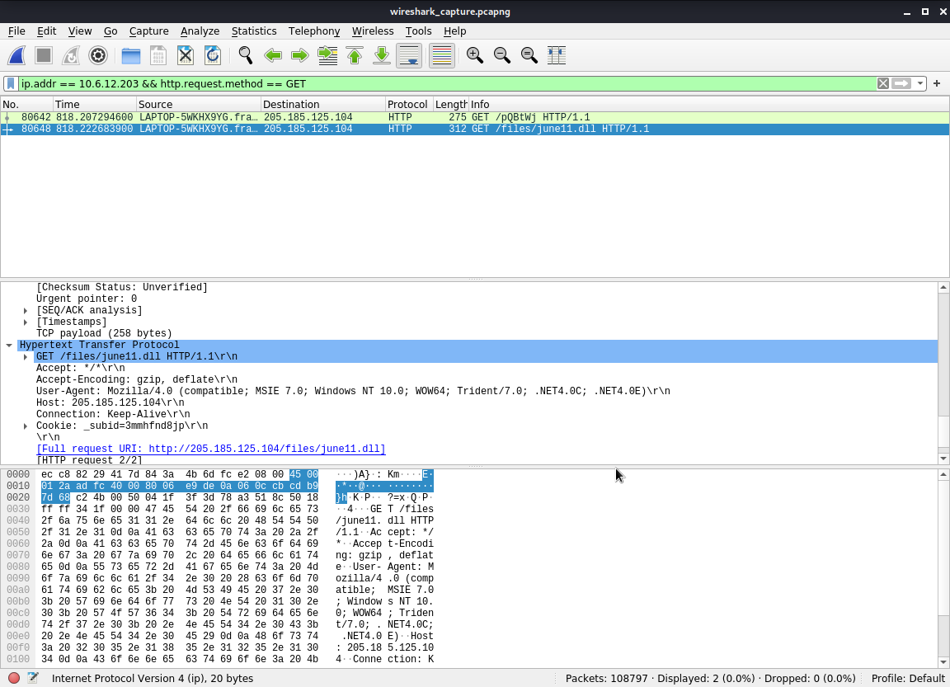
DOWNLOADING MALWARE
Summary :
The ip address : 10.6.12.203 downloaded a malware (june11.dll) onto his system over HTTP protocol. It was downloaded from this ip address : 205.185.125.104. Further investigation into the malware revealed it was Trojan.

Slide 18
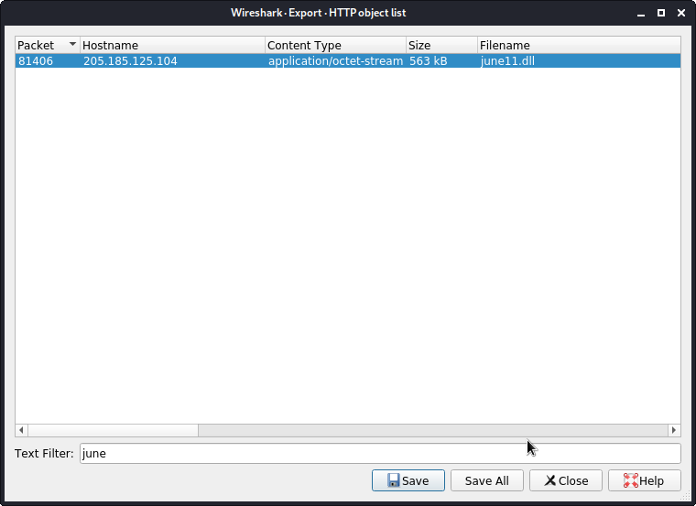
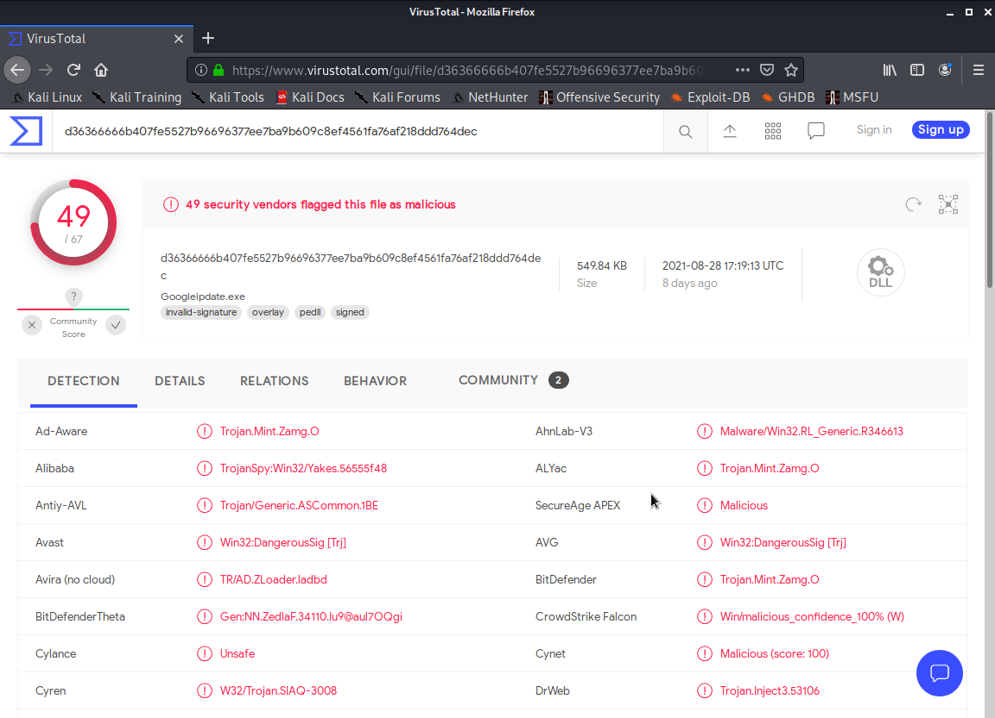
DOWNLOADING MALWARE
Summary : screenshots
Malware being exported for investigation Malware revealed to be a TROJAN by virustotal.com

Slide 19

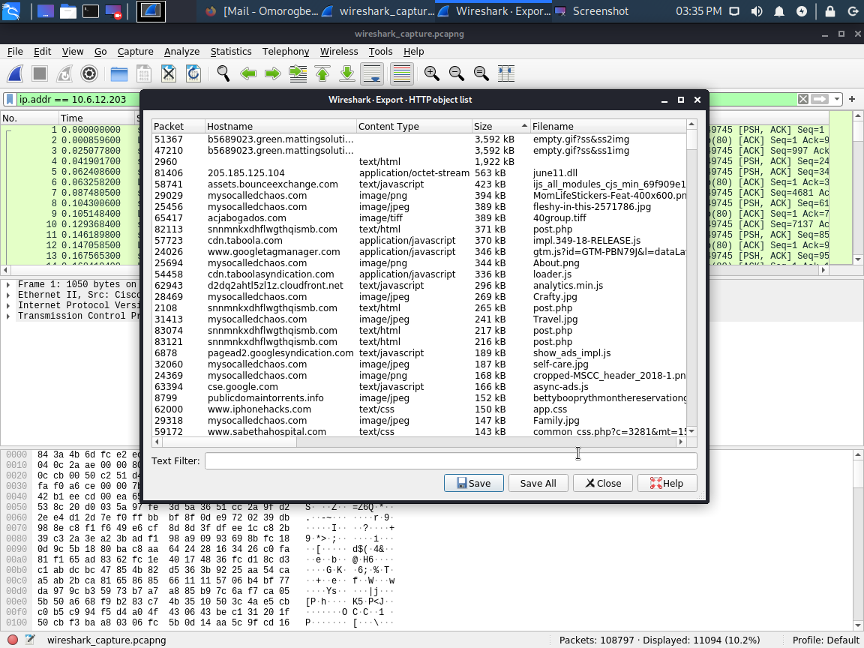
OPTIONAL ACTIVITY
DESKTOP BACKGROUND
I was able to get the desktop background image for the windows user with IP : 10.6.12.203.

Slide 20
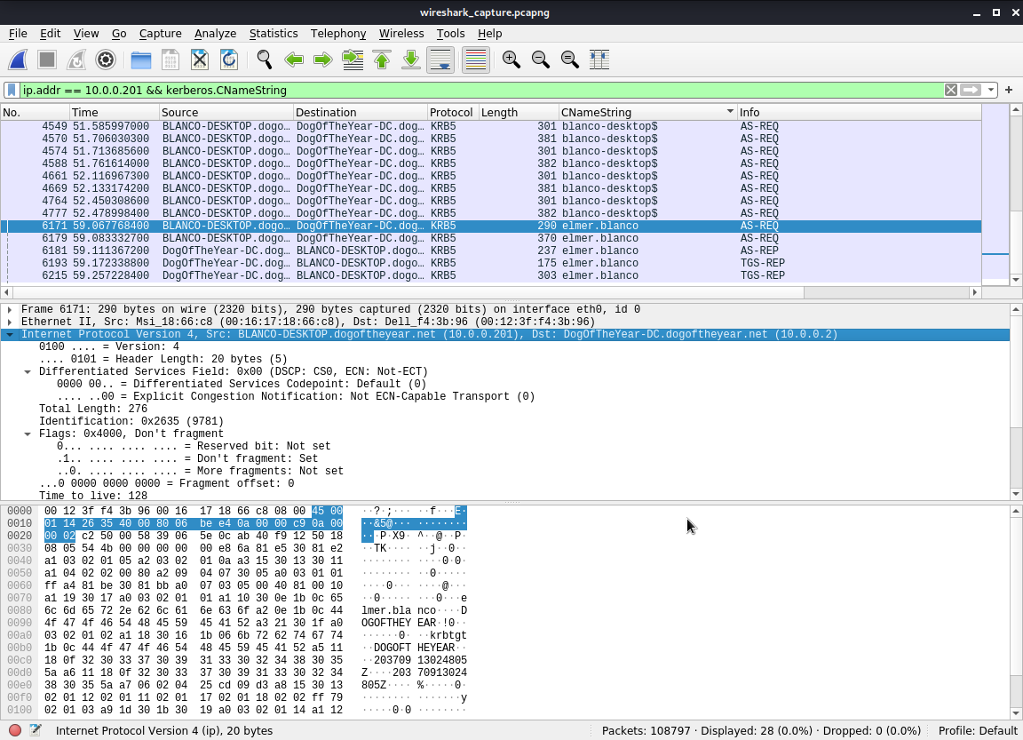
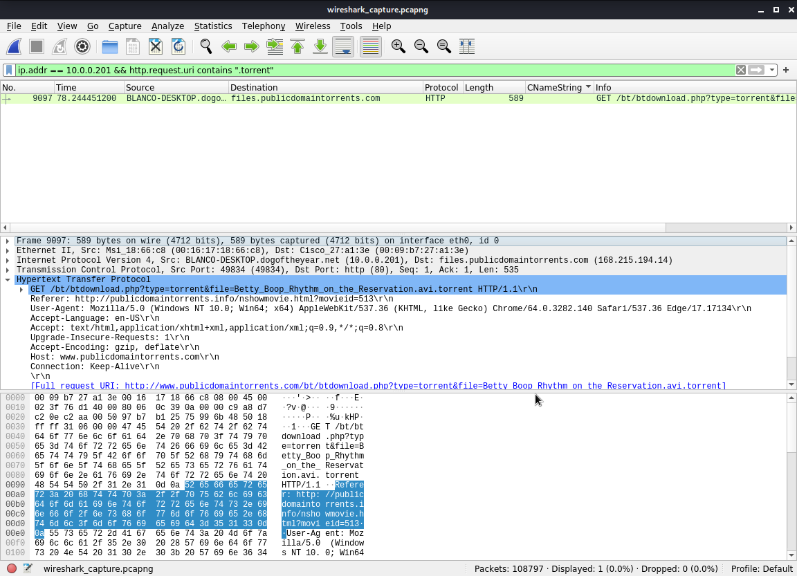
COPYRIGHT INFRINGEMENT DOWNLOADS USING TORRENTS
Summary :
A user on the network used torrents to download a file that breaches the copyright infringements policy of the company. the user uses a windows machine with username : elmer.blanco, IP : 10.0.0.201. The torrent file downloaded was : Betty_Boop_Rythm_on_the_Reservation.avi.torrent.
uncovering the windows username uncovering the illegal file downloaded through torrents.

Slide 21
The End
‹#›

